Slide 1
Sitecore Pathfinder
Get started, get far, get happy!

Slide 2

New Sitecore toolchain
Sitecore Pathfinder
Build Sitecore website using favorite tools and a familiar approach
From project directory to website
Two parts: Compiler and Installer

Slide 3
Pathfinder compiler
Compiles source files into a deliverable package
Everything is a file (items, media, renderings, configs etc.)
Project contains the whole truth
Compiler checks validity and ensures integrity
Command-line tool

Slide 4
Pathfinder installer
Installs the deliverable package into a Sitecore website
Supports NuGet packages
Supports NuGet dependencies
Sitecore.Pathfinder.Core NuGet package

Slide 5
Projects

Slide 6
Developer experience
Work with Sitecore items the same way you work with source code (including source control)
Edit source files
Compile
Check result
Repeat
Pathfinder can infer and implicitly create Sitecore items from media files, renderings and more

Slide 7
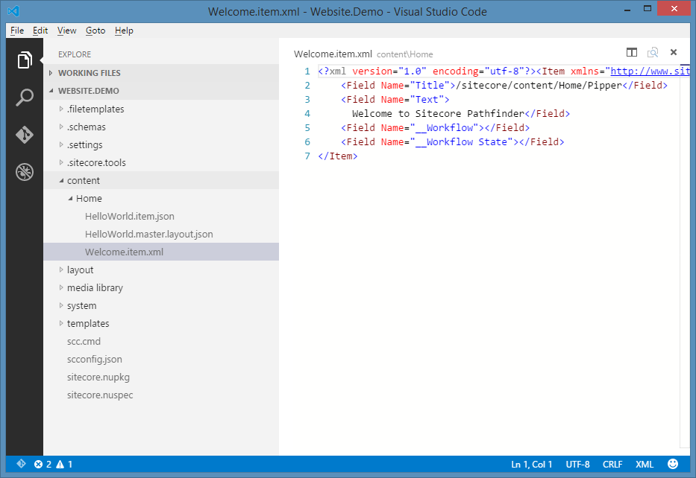
Editor agnostic
Use your favorite editor, e.g.
Notepad
Notepad++
SublimeText
Code
Visual Studio is not a requirement

Slide 8
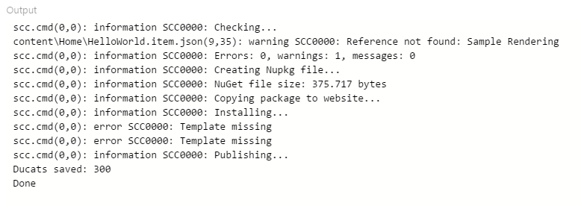
Build process agnostic
Use any modern build process
GruntJS
GulpJS
MSBuild
Command line
Continuous integration friendly

Slide 9
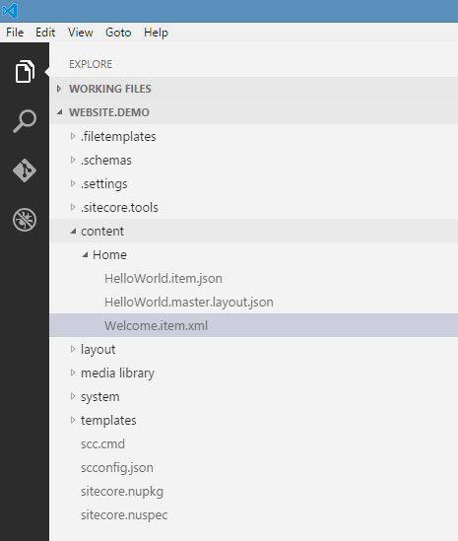
Project
Project has the whole and single truth
Code, assets and resources are not spread across Sitecore databases, websites, development projects etc.
A project is just a filesystem directory
Source control friendly

Slide 10
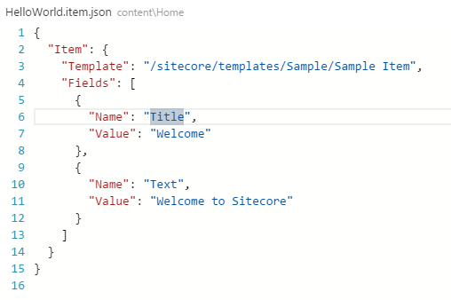
Items
Items are just files
Format agnostic
Json
Xml
Serialized items (not human editable)
Items are created in the project as files – not in the Content Editor (or Sitecore Rocks)

Slide 11
Deploying
Deploying is part of the build process
Supports project dependencies through NuGet dependencies

